Slide 1
Ab initio gene finding
Transcriptome sequencing data does not provide comprehensive picture of expression – not all transcripts are expressed in all cells at the same time:
  Sequence many different cells under many conditions (expensive)
  Supplement transcriptome sequencing data with an ab initio gene finding algorithm to find transcripts that a not expressed
Assembled transcripts have errors:
  Use machine learning algorithms to detect errors in assembled transcripts
Machine learning:
  Positional Weights/Markov chain/Hidden Markov Models
  Convolution Neural Networks?

Slide 2
Machine learning algorithms
Protein coding and non-coding sequences have different patterns of letters
Spliceosome does not just cut out introns at GT-AG, it recognizes longer patterns around splice sites
We can look for the patterns with machine learning algorithms
We can model and test the patterns with:
  Positional Probabilities or Positional Weights
  Markov chains
  Hidden Markov Models

Slide 3
Markov chains and HMMs
We can use Positional Probabilities and Markov chains to test whether the sequence patterns around features (such as splice sites GT-AG) correspond to what is expected, which allows us to:
  Look for new features
  Test for correctness of existing features obtained from the data
We will consider application of Positional Probabilities and Markov chains to splice site prediction/validation
We can use HMMs to locate regions of sequence that appear to have different properties (coding vs. non-coding)

Slide 4
Positional Probabilities
Positional probabilities is the most straightforward approach to detecting and testing sequence patterns
Positional probabilities simply quantify the probabilities of observing A,C,G,T at a certain location in genomic sequence

Slide 5

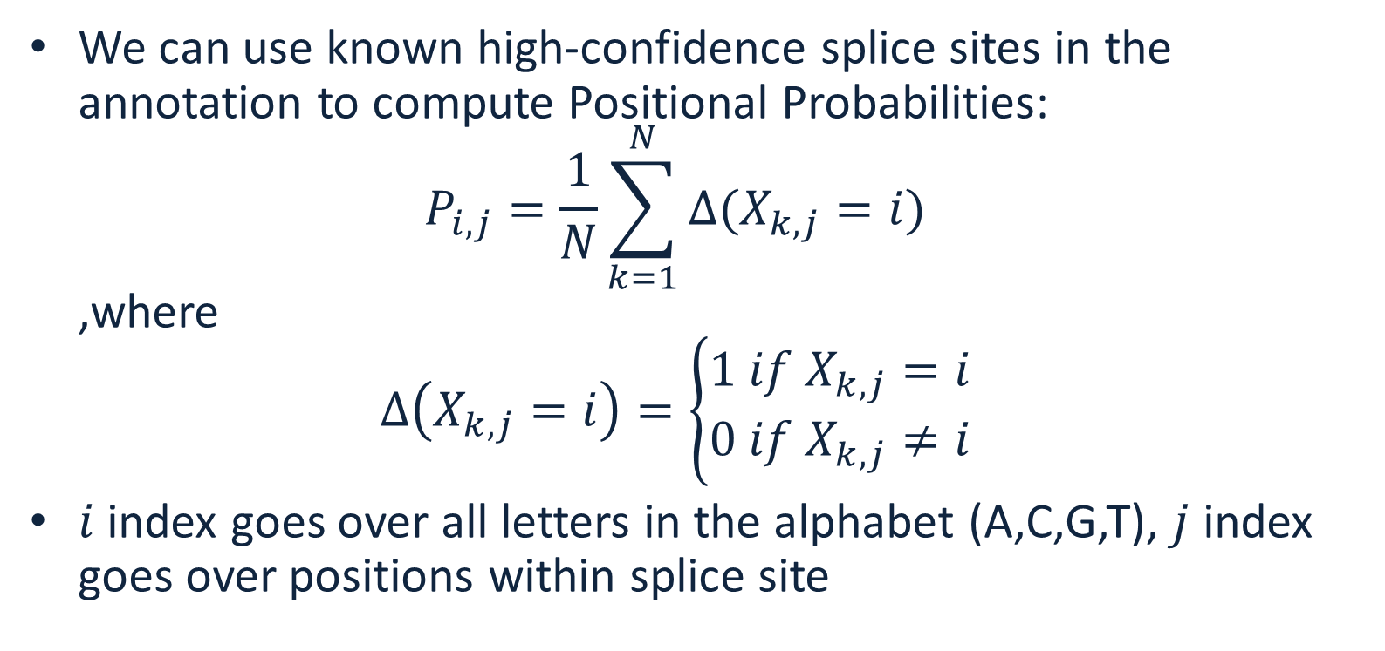
Positional probabilities
We can use known high-confidence splice sites in the annotation to compute Positional Probabilities:
$P_{i,j}=\frac{1}{N}\sum_{k=1}^{N}{∆(X_{k,j}=i)}$
,where
$∆\left(X_{k,j}=i\right)=\left\{\begin{matrix}1 if{ X}_{k,j}=i \\ 0 if{ X}_{k,j}≠i\end{matrix}\right.$
$i$ index goes over all letters in the alphabet (A,C,G,T), $j$ index goes over positions within splice site

Slide 6
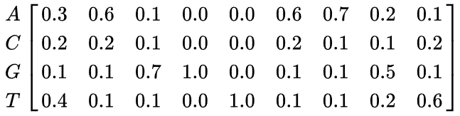

Example
Given DNA sequences:
The Positional Probability Matrix (PPM) is
Computing these probabilities from the data is the learning part
$P_{i,j}=$

Slide 7
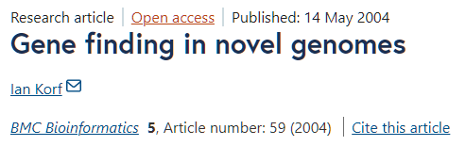
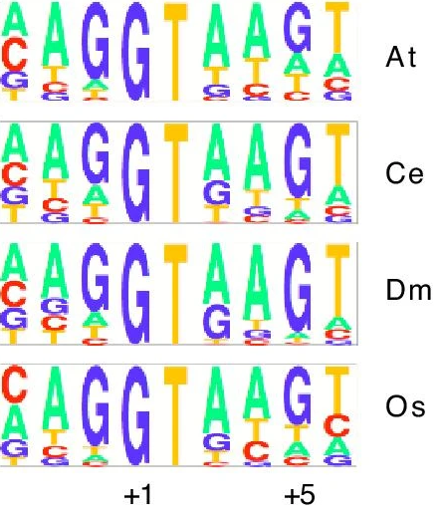
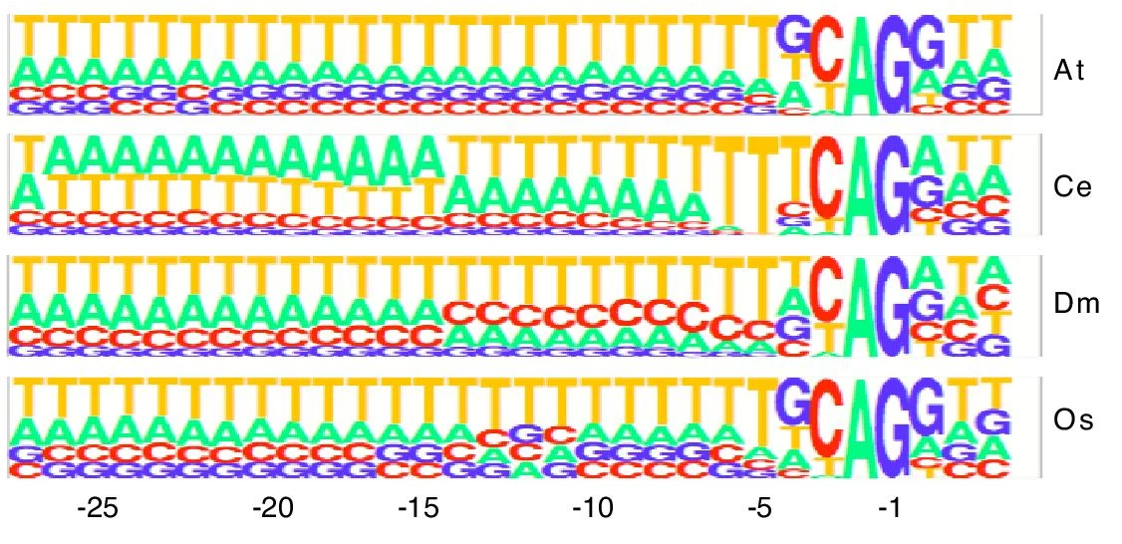
Splice site patterns
Donor (GT)
Acceptor (AG)

Slide 8

Using PWM to evaluate pattern
We can calculate the probability of a sequence given a PPM, by multiplying the relevant probabilities at each position. For example, the probability of the sequence S = GAGGTAAAC can be calculated:
Compare this to the probability of a random sequence (all probabilities are 0.25) 0.25^9=0.0000038
${P_{i,j}}_{ }=$
$${p(S|P}_{i,j})=.1∗.6∗.7∗1∗1∗.1∗.7∗.2∗.2=0.0007056$$

Slide 9
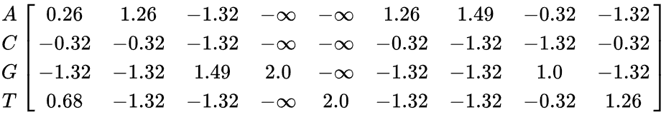
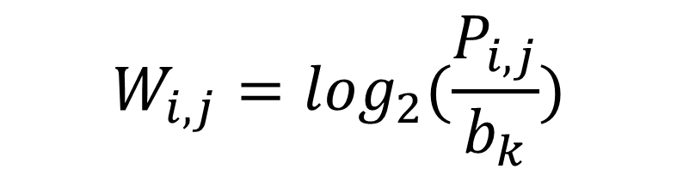
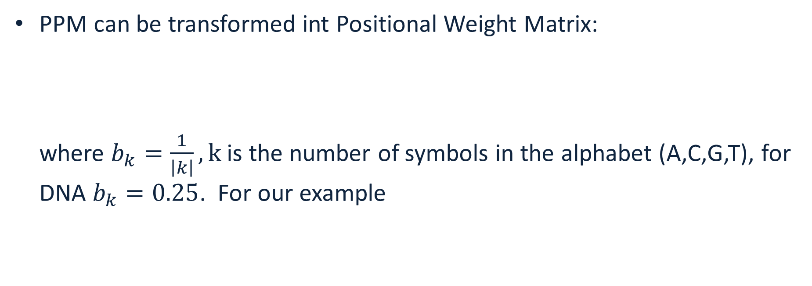
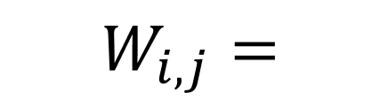
PPM vs PWM
PPM can be transformed int Positional Weight Matrix:
where $b_{k}=\frac{1}{\left|k\right|}, k$ is the number of symbols in the alphabet (A,C,G,T), for DNA $b_{k}=0.25$. For our example
$$W_{i,j}=\log_{2}(\frac{P_{i,j}}{b_{k}})$$
$$W_{i,j}=$$

Slide 10
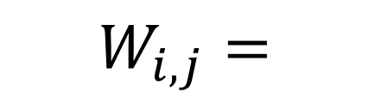
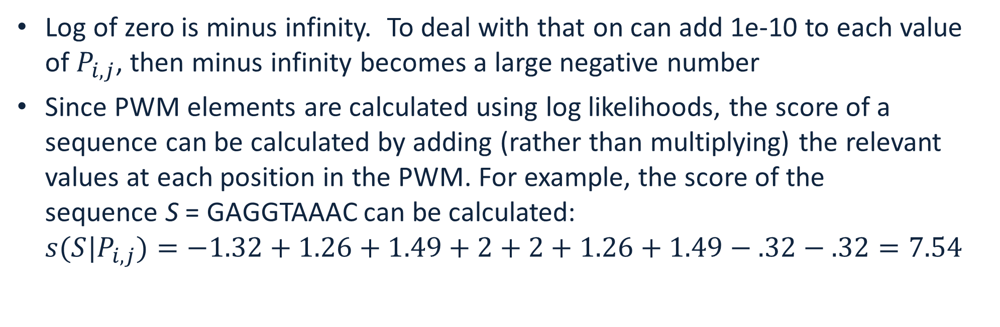
Scoring with PWMs
Log of zero is minus infinity. To deal with that on can add 1e-10 to each value of $P_{i,j}$, then minus infinity becomes a large negative number
Since PWM elements are calculated using log likelihoods, the score of a sequence can be calculated by adding (rather than multiplying) the relevant values at each position in the PWM. For example, the score of the sequence S = GAGGTAAAC can be calculated:
${s(S|P}_{i,j})=−1.32+1.26+1.49+2+2+1.26+1.49−.32−.32=7.54$
$$W_{i,j}=$$

Slide 11
PWM score
The sequence score gives an indication of how different the sequence is from a random sequence (all weights are the same).
The score is 0 if the sequence has the same probability of being a valid pattern (splice site) and of being a random site.
The score is greater than 0 if it is more likely to be a valid splice site than a random site, and less than 0 if it is more likely to be a random site than a valid splice site.
This can be generalized to look or test any feature (donor splice site, acceptor splice site, coding start, coding stop)

Slide 12
Drawback of PWMs
PWMs assume statistical independence between positions in the pattern, as the probabilities for each position are calculated independently of other positions.
This assumption does not match reality for splice site patterns
Longer correlations are present

Slide 13
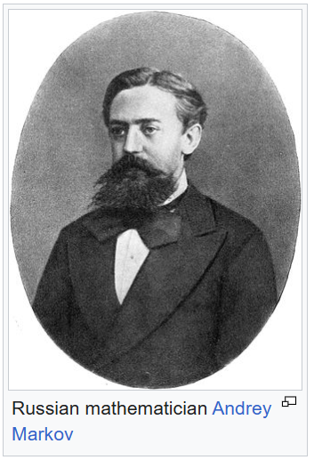
Markov chain
Markov chains allow one to quantify correlations in patterns
Markov chain or Markov process is a stochastic process describing a sequence of possible events in which the probability of each event depends only on the state attained in the previous event.
Informally, this may be thought of as, "What happens next depends only on the state of affairs now."
Markov processes are named in honor of the Russian mathematician Andrey Markov.

Slide 14
Markov chain
We will consider Discrete-time Markov Chains
A discrete-time Markov chain is a sequence of random variables X₁, X₂, X₃, ... with the Markov property, namely that the probability the next state depends only on the previous states:
Order of the Markov chain is equal to the number of the previous states considered to determine the probability of the next state

Slide 15

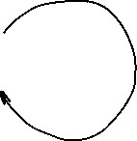

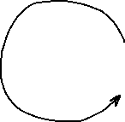
Markov model
Markov model has:
A set of states
Transition probabilities between states
Probabilities of the starting states
Transition probability matrix:
To
B G
From B 0.2 0.8
G 0.5 0.5
Starting probabilities
Pr(B) = 0.6
Pr(G) = 0.4
Markov walk:
BGGBGBGGGBBGBGGGBGGGGB
Outgoing probabilities must sum to 1 !
0.2
0.8
0.5
0.5

Slide 16

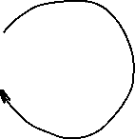

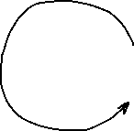
Markov model
For any observed walk we can compute probability that this process generated the walk:
Pr(BGGB)=0.6*0.8*0.5*0.5=0.072
How is this probability useful?
We can use it to distinguish between two Markov Processes!
Transition probability matrix:
To
B G
From B 0.2 0.8
G 0.5 0.5
Starting probabilities
Pr(B) = 0.6
Pr(G) = 0.4
0.2
0.8
0.5
0.5

Slide 17
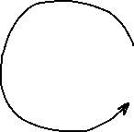

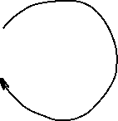
Markov model
Process A Pr(BGGB)=0.6*0.8*0.5*0.5=0.072
Process B Pr(BGGB)=0.5*0.5*0.5*0.5=0.0625
Process A is more likely!
Process A: Starting probabilities Pr(B)=0.6, Pr(G)=0.4
0.2
0.8
Process B: Starting probabilities Pr(B)=0.5, Pr(G)=0.5
0.5
0.5
0.5
0.5
0.5
0.5

Slide 18

Training Markov chain
Training Markov chain involves estimating transition probability matrix from the data under a given model
Consider 1st order Markov chain for DNA. The probability of the next letter depends only on the previous letter in the pattern
One can estimate transition probabilities by counting all tuples T_{i}=(“AA”,”AC”,”AG”,”AT”,”CA”,....,”TT”) in the DNA data, and dividing the count of each tuple starting with A, C, G, T by the total number of T_{i} starting with A, C, G and T
To
A C G T
A .1 .4 .4 .1
From C .2 .2 .3 .3
G .4 .4 .1 .1
T .5 .1 .2 .2
rows must add up to 1
A
C
G
T

Slide 19

Scoring with Markov chain
Imagine sequence AGCG, all starting probabilities are equal to 0.25. Its probability under this Markov model is P = 0.25*0.4*0.4*0.5
You can compare probabilities between different Markov chain models to see which model is more likely to have generated the pattern
To
A C G T
A .1 .4 .4 .1
From C .2 .2 .3 .3
G .4 .4 .1 .1
T .5 .1 .2 .2
rows must add up to 1
A
C
G
T

Slide 20



Markov Weight Array Matrix
A Weight Array Matrix is a specific kind of Markov chain model that incorporates positions within the pattern
WAM works better than PWM in scoring patterns because it incorporates Markov chain transition probabilities
Computation of probabilities is the same as for the PPM, except the alphabet is tuples (“AA”,”AC”,”AG”,”AT”,”CA”,....,”TT”), size=16
Let each tuple be
Compute probabilities for every , for a pattern of length n, the matrix will have dimensions 16 by (n-1)
$$T_{i}$$
$$T_{i}$$
$$P_{i,j}^{M}$$

Slide 21
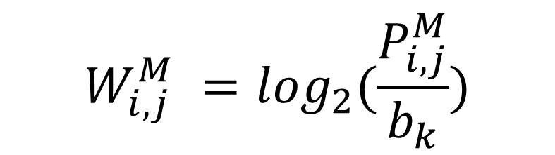
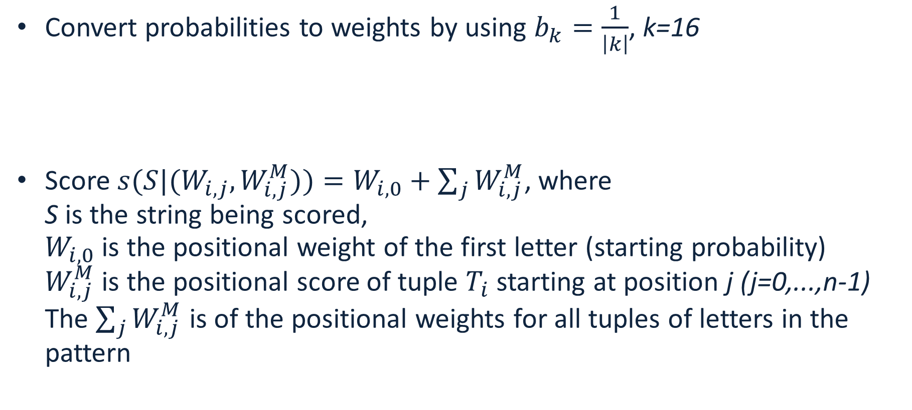
Scoring with Markov WAM
Convert probabilities to weights by using $b_{k}=\frac{1}{\left|k\right|}$, k=16
Score ${s(S|(W}_{i,j},W_{i,j}^{M}))=W_{i,0}+\sum_{j}{W_{i,j}^{M}}$, where
S is the string being scored,
$W_{i,0}$ is the positional weight of the first letter (starting probability)
$W_{i,j}^{M}$ is the positional score of tuple $T_{i}$ starting at position j (j=0,...,n-1) The $\sum_{j}{W_{i,j}^{M}}$ is of the positional weights for all tuples of letters in the pattern
$$W_{i,j}^{M} =\log_{2}(\frac{P_{i,j}^{M}}{b_{k}})$$

